Slide 1










WP2.1 Consumption
What is needed to implement the @HBS app?
Bilateral meetings, March-April 2020
STATEC
ESSNET SMART SURVEYS

Slide 2
Assistance in phases 2/2’ and 3
Usability test plans, protocols and reports from @HBS
All texts for translation prepared in an easy form
English product and shop lists
Answers to FAQ
Bilateral video meetings
NL starts Q3 2020 with field tests to inform other NSI’s
STATEC
ESSNET SMART SURVEYS

Slide 3
Timeline WP2.1
Phase | Timing | Size | App language | Lists | Scanning
Evaluation | Mar-May | NA | English | NL-EN lists | OCR NL-EN No classification
Basic test | Apr-Aug | Small | Country | NL-EN lists translated | OCR NL-EN Classification NL
Usability test | Jul – Dec | 10-20 | Country | Country lists | OCR all countries Classification NL
Fieldtest | Jul – Jul ‘21 | 800 | Country | Country lists | OCR all countries Class all countries
STATEC
ESSNET SMART SURVEYS

Slide 4
WP2.1 input
User interface texts
Text in app store
Lists:
Products (linked to COICOP)
Shop types and names
Scanning/processing receipts:
Examples of receipts (to learn format and structure)
Product descriptions, OR
Annotated receipts
STATEC
ESSNET SMART SURVEYS

Slide 5
WP2.1 input – UI texts
App has four main screens (calendar, overview purchases, statistics and settings) and a number of data entry screens.
Each screen is included in an English Excel file including corresponding screenshots
A few iterations may be needed, because of context/button sizes/etc
STATEC
ESSNET SMART SURVEYS

Slide 6
WP2.1 input – app store
Description of app when opening app store
STATEC
ESSNET SMART SURVEYS

Slide 7
WP2.1 input – products
Crucial list, as it strongly determines usability
Product list is “5th” COICOP level but in every day language
Each item should be uniquely linked to 4digit COICOP
STATEC
ESSNET SMART SURVEYS

Slide 8
WP2.1 input – shop names and types
In NL around 50 shop types and 6000 shop names
Shop types can be translated by hand (or with Google translate)
Shop name list needs to be constructed in time
STATEC
ESSNET SMART SURVEYS

Slide 9
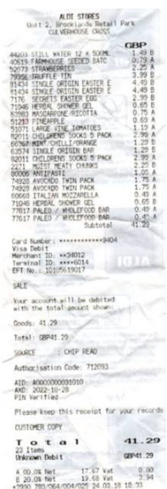
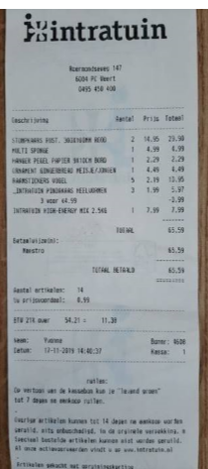
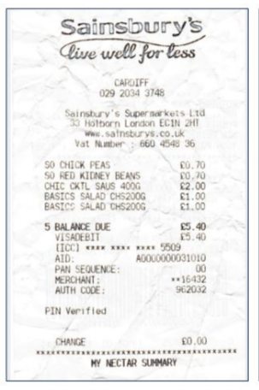
WP2.1 input - receipt formats
How many columns do receipts have?
Do they contain EAN/GTIN codes?
How about discount formats?
STATEC
ESSNET SMART SURVEYS

Slide 10
WP2.1 input – product descriptions
Crucial for classification of products-prices to COICOP
Can be a by-product (metadata) of scanner transactions data
Only alternative is training machine learning models/CASCOT
STATEC
ESSNET SMART SURVEYS

